Slide 1

Data Analytics with Python
Forbes Billionaires List 2021
Nivedita Thapa, Ruchira Teli, Shruti Garg,Celine Tsai

Slide 2
Agenda
01
About the Dataset
02
Data Cleaning and Preparation
03
Data Manipulation and Visualization
04
Data Regression
05
Results

Slide 3
About the Dataset
Forbes Billionaires of 2021 Dataset
There are 2,755 number of billionaires on Forbes’ 35th annual world’s wealthiest list.
The net worth in the dataset is based on stock prices and exchange rates from March 5.
Dataset has columns as follows : Name, Net Worth, Country, Source, Rank, Age, Residence, Citizenship, (Relationship) Status, Children, Education, Self-made
Why this Dataset
Observe the factors that affect one’s success
Often told having a more advanced degree opens up more opportunities
Does having an advanced degree contribute to one’s success?
Source: https://www.kaggle.com/roysouravcu/forbes-billionaires-of-2021

Slide 4
Data Cleaning and Preparation
Splitting Education
Separated into DEGREE_1, DEGREE_2, UNIV_1_COMPLETION, UNIV_2_COMPLETION
Splitting
Residence
Dealing with Special Characters
Separated into CITY and STATE columns
Missing Values
Replaced with np.nan
Data Format
Filled values with np.nan
Converted all columns into upper case
Notes:
Working on the column Names : Upper Case
Worked on the column Data
Missing values : Filled by 0 or Null values
‘Source’ Column Data was not in proper form : Had few punctuations instead of characters
Status Column Data had discrepancies :
Split the column data
Education column is split into Education1 , Degree1,Education2,Degree 2
Separate the city from the state
5. Change the Data Types of column

Slide 5

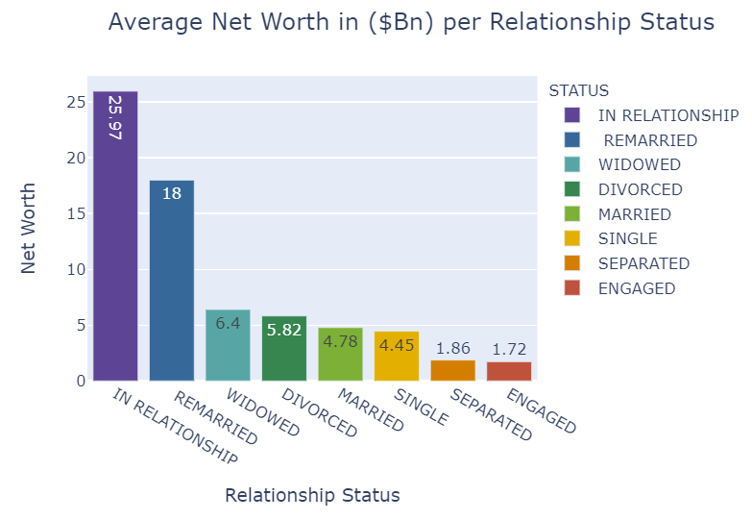
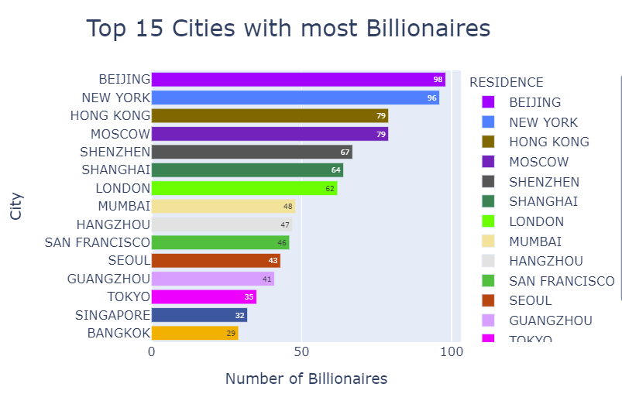
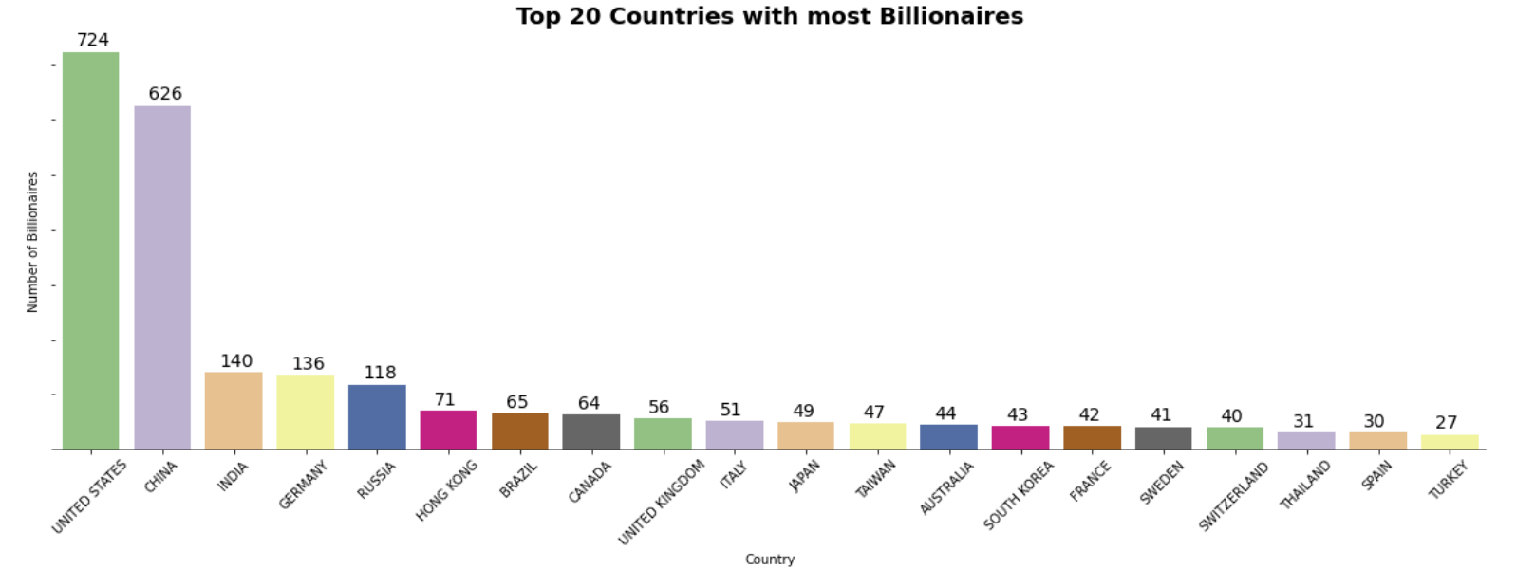
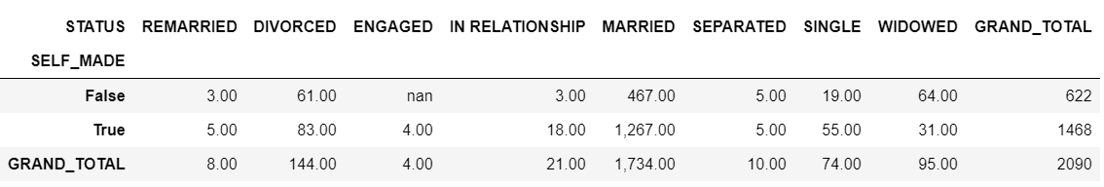
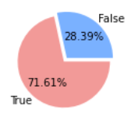
Data Manipulation & Visualizations (1/2)
Count of Billionaires based on their Relationship Status & if they are Self Made
Top 15 cities with most number of Billionaires
Approach : Pivot Table with index as SELF_MADE, columns as STATUS, values as NAME, aggfunc as len and margin name as ‘GRAND TOTAL’
Analysis of the relationship between Net Worth and Relationship Status
Top 20 Countries with Maximum Billionaires & Total number of Billionaires in the list
Approach : Group by RESIDENCE and the count the NAME of these RESIDENCE, sort this data by Name and reset the index the rename Y – axis as City and X- axis as Number of Billionaires
Insights
Approach : Group by STATUS and then find the mean net worth , round it to the two decimal value and sort the net worth in descending order of preference
Approach : Value Counts of the ‘Country’ column in the Table followed by the Sum
Insights
We can see that there are more self-made billionaires than the ones who are not self-made. So this means that if you put your best effort into your passion, you could also become one of them.
Insights
China and the US had the highest number of billionaires, it can be expected that the cities of the these countries also have the highest number of billionaires.
Surprisingly, out of the top 15 cities with the most billionaires, China has 6 cities whereas the US has only 2. This shows that billionaires are spread out more across the country in China as opposed to the US..
Insights
United States has the most number of Billionaires, China is equally challenging US by adding more number of Billionaires to its list followed by India .
There are 2755 people in 2021 billionaires list.
The results above show that billionaires that are in a relationship have the highest average net worth.
The average net worth of billionaires who are with someone (whether they are in a relationship, engaged, married or remarried) is higher than those who are not with someone.

Slide 6
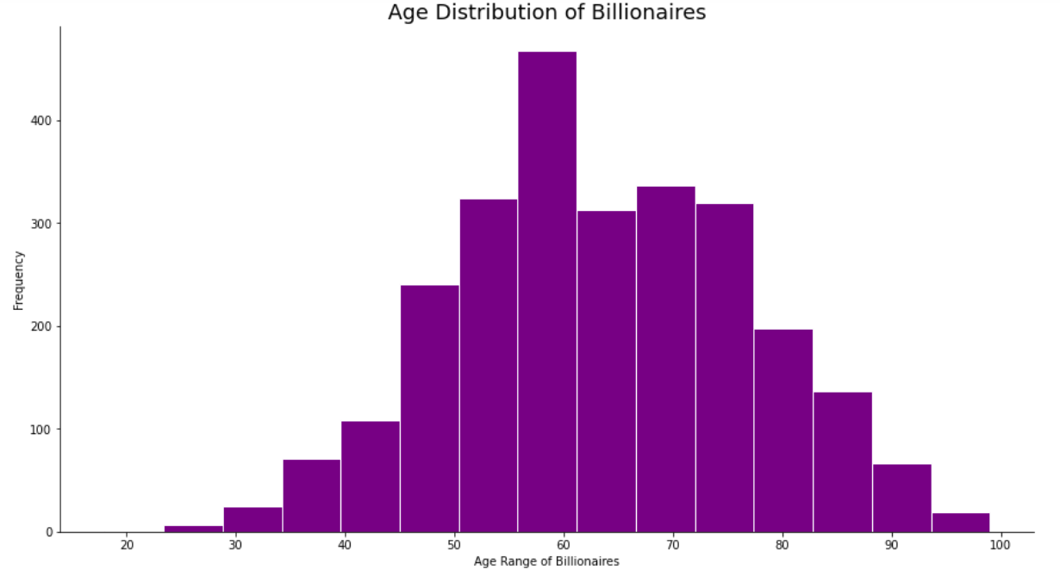
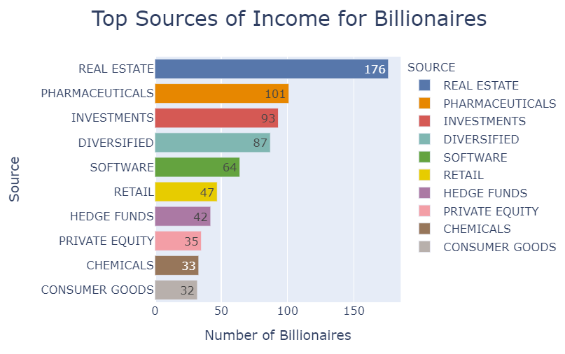
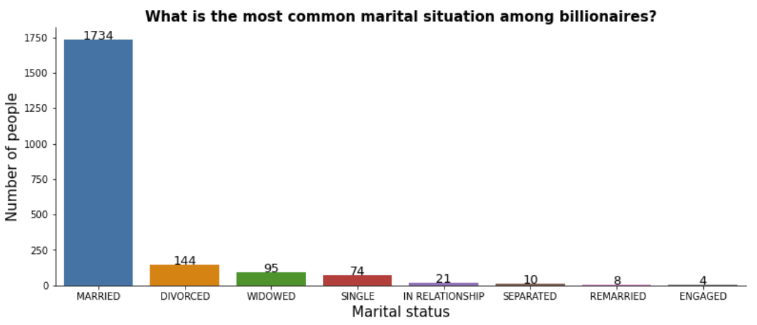
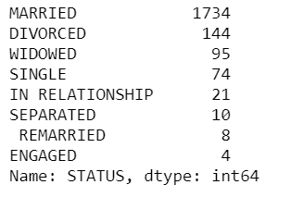
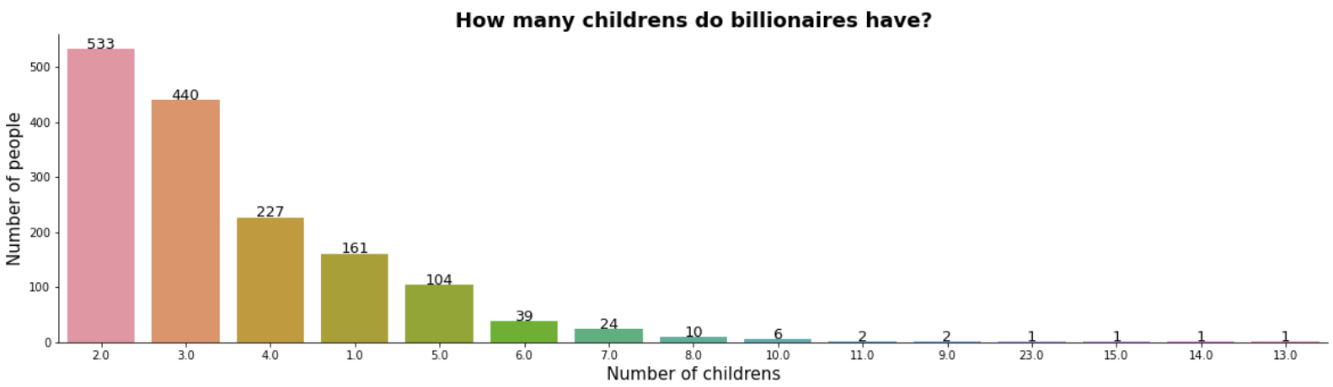
Data Manipulation & Visualizations (2/2)
Find the Oldest and the Youngest Billionaire’s Age
How many children do billionaires have.
Who has the most and least number of children's.
The most common relationship status among billionaires
Analysis of the most common sources of income
Approach : Find the max and min AGE in the column and then append these to display in a single table
Approach : Value Counts for CHILDREN column and Max value in the CHILDREN column & display the result
Approach : Group by SOURCE and then find the calculate the count of the NAME, sort the values of NAME in the ascending order and rest the index
Approach : For Column STATUS find the value counts
Insights
The oldest billionaire is George Joseph (born September 11, 1921), that is the founder of Mercury Insurance Group of Los Angeles.
The youngest billionaire is Kevin David Lehmann, billionaire since he was 14.He is now eighteen, he has inherited from his father the "dm" grocery chain, the largest in Europe.
Insights
Insights
Insights
There are around 533 Billionaires who have 2 children.
It certainly seems strange to hear that a man can have 23 children, in fact, Mr. Roman Avdeev adopted 19. He adopted the first two children in 2002 when he realized that his help with orphanages was ineffective.
Love triumphs even among billionaires as there is a large majority of married billionaires, unfortunately followed by many divorced.
Undoubtedly Real - Estate is the most common source of income with 176 billionaires, followed by Pharmaceuticals & Software holds the position 4 with 64 billionaires.

Slide 7
Data Analysis - Regression

Slide 8
Conclusion
Content Here
Get a modern PowerPoint Presentation that is beautifully designed.
Content Here
Get a modern PowerPoint Presentation that is beautifully designed.
Content Here
Get a modern PowerPoint Presentation that is beautifully designed.
Content Here
Get a modern PowerPoint Presentation that is beautifully designed.
Get a modern PowerPoint Presentation that is beautifully designed.

Slide 9
Any Questions?
Thanks for listening !

